Slide 1



Data Science
By Nail Ghazali

Slide 2


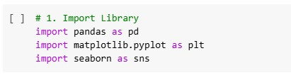
Import Library
In this step, we import three main libraries: pandas for data manipulation, matplotlib.pyplot for creating simple visualizations like bar or line charts, and seaborn for more attractive and informative visualizations. These libraries are essential foundations for the Exploratory Data Analysis process.

Slide 3


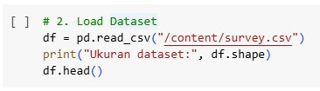
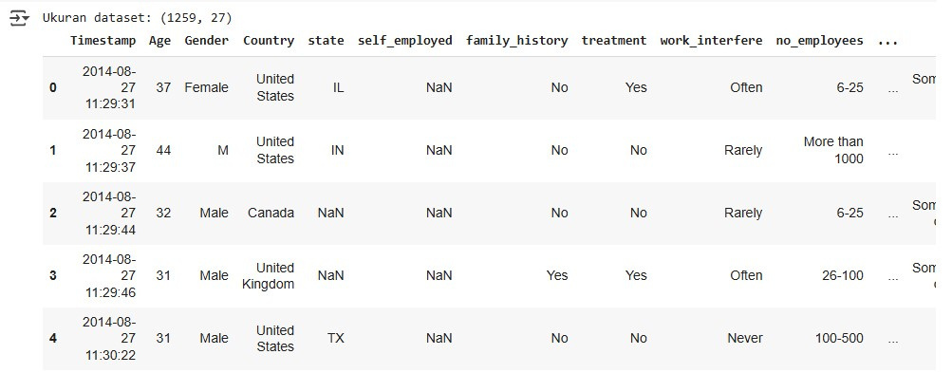
Load Dataset
The dataset is loaded using the read_csv() function from pandas. The CSV file should already be available in the working directory, such as being uploaded to Google Colab. After loading, the shape function is used to view the number of rows and columns to understand the dataset size.

Slide 4

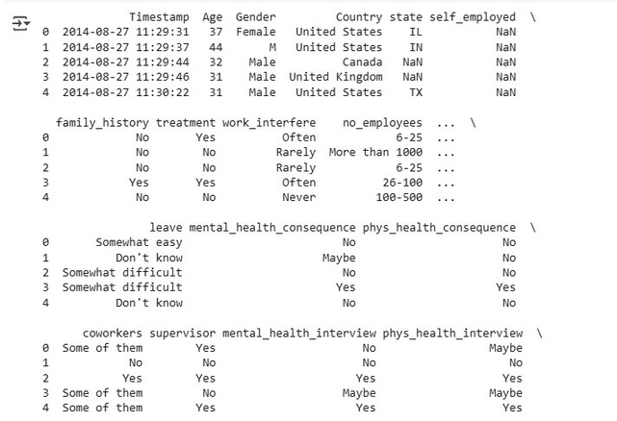


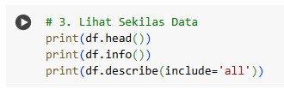
Lihat Sekilas Data
We display the first few rows using head(), and use info() and describe() to get an overview of the data's structure and statistics. This helps us understand the data types of each column and view summaries like minimum, maximum, and average values.

Slide 5
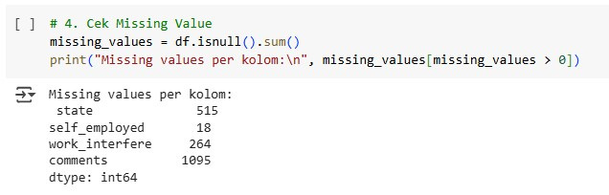

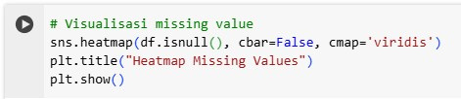

Cek Missing Velue
This step identifies whether there are missing or null values in the data. The isnull().sum() function calculates how many missing values are in each column. Additionally, a heatmap visualization helps visually identify where the missing data occurs.

Slide 6

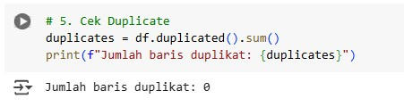
Cek
Duplicate
After checking for missing values, we examine whether there are any exact duplicate rows. This is done using the duplicated() function and drop_duplicates() to remove them. Duplicates can affect the analysis results if not handled properly.

Slide 7
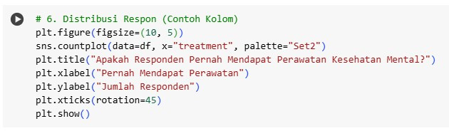

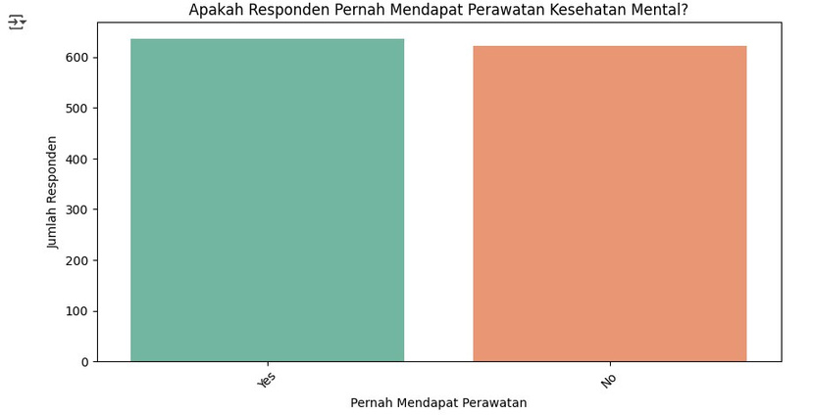
This step is carried out to understand how the respondents' answers are distributed, especially in the treatment column which indicates whether the respondent has received mental health treatment. A barplot visualization is very useful to see the proportion of each response category (such as "Yes", "No", "Don’t know"). This is important as it provides a general overview of respondent conditions and can serve as a basis for further analysis on certain patterns or trends.
Distribusi Respon

Slide 8


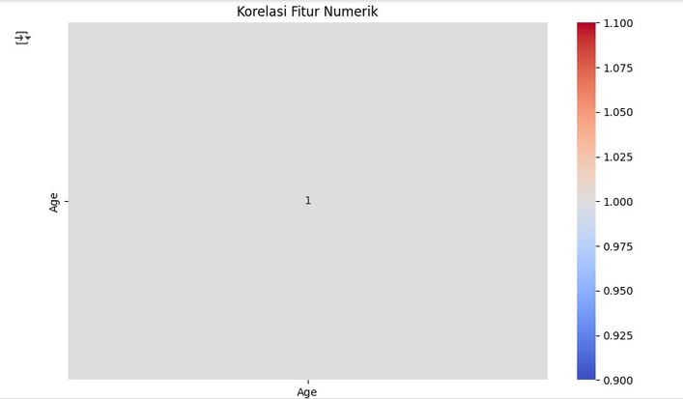
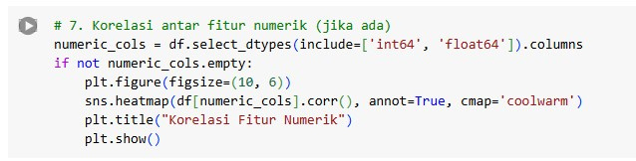
Korelasi Antar Fitur Numerik
In this step, correlations between numerical features such as age are calculated to see if there are relationships between variables in the dataset. The correlation results are visualized using a heatmap, where the colors indicate the strength and direction of the relationships. This analysis is useful for identifying patterns or related variables that are relevant for further analysis.

Slide 9

Thank You
081226110306
Nail Ghazali
nailghazali21@gmail.com

